Slide 1




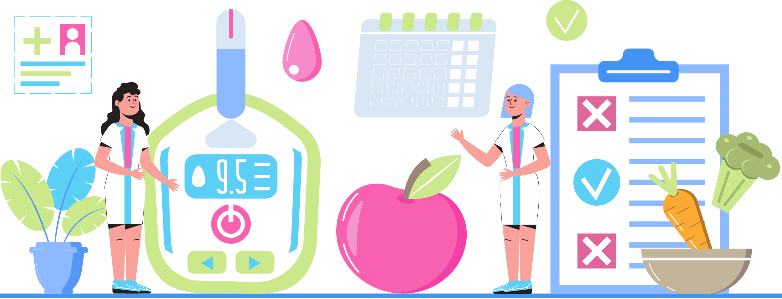



DIABETES ACTIVITY PROGRAM
What is Diabetes & What Can I Eat?
Stephanie Hevenor, RD, CDE
This program is sponsored by Boehringer Ingelheim through the K2A Challenge in Diabetes! in partnership with Bancroft Fitness and the Bancroft Community Family Health Team

Slide 2
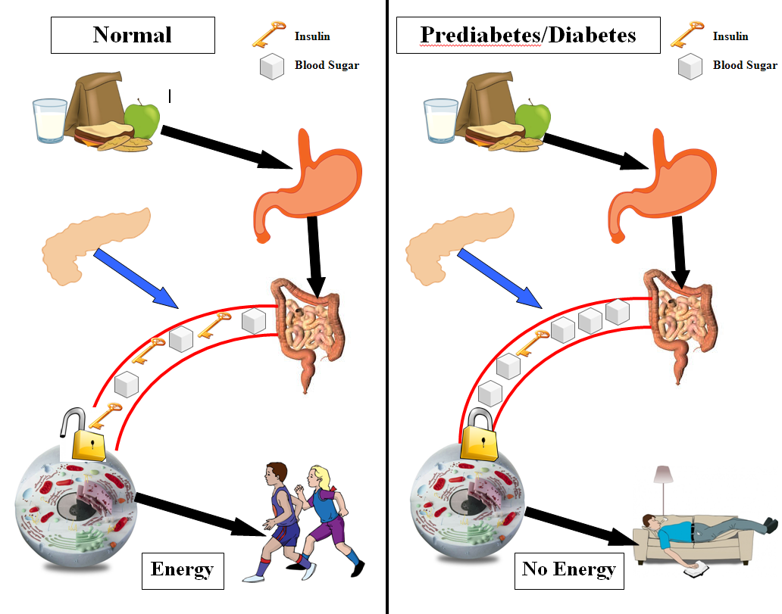



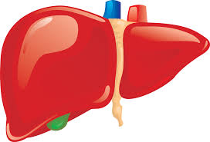
Healthy Pancreas
Diabetes/Prediabetes
What Is Diabetes?
STOMACH
PANCREAS
INTESTINES
LIVER
CELL
Notes:
Diabetes is a condition in which the body cannot properly use or store energy from food
Slide from QHC-DEC presentation “Healthy Lifestyle for Blood Sugar Management.
Pathophysiology of diabetes from Diabetes Canada Essentials Chapter 3.

Slide 3

When Should I Eat?
3 meals per day
Meals should be 4-6 hours apart
Example:
      8:00 AM - Breakfast
      12:00 PM - Lunch
      5:00 PM - Supper
2-3 snacks per day if hungry in between meals
Sievenpiper, J. L., Chan, C. B., Dworatzek, P. D., Freeze, C., Williams, S. L., & Diabetes Canada Clinical Practice Guidelines Expert Committee. (2018). Nutrition therapy. Canadian journal of diabetes, 42, S64-S79.
Notes:
What we eat is often influenced by when we eat.

Slide 4

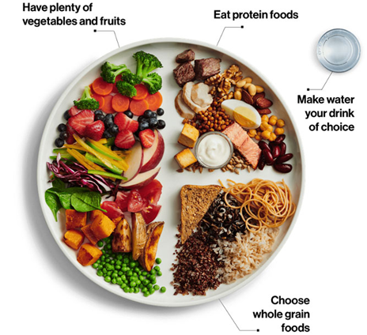
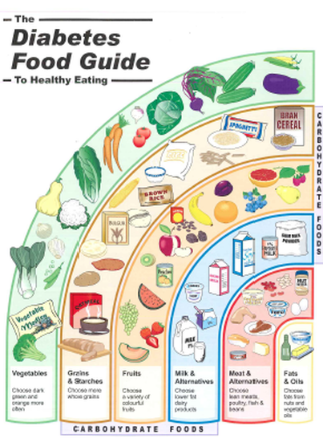
What should I eat?
Centretown Community Health Centre. (2018). Diabetes Food Guide. https://diabeteseducation.ca/en/For%20HC
Government of Canada. (2025). Canada’s Food Guide. https://food-guide.canada.ca/en/

Slide 5
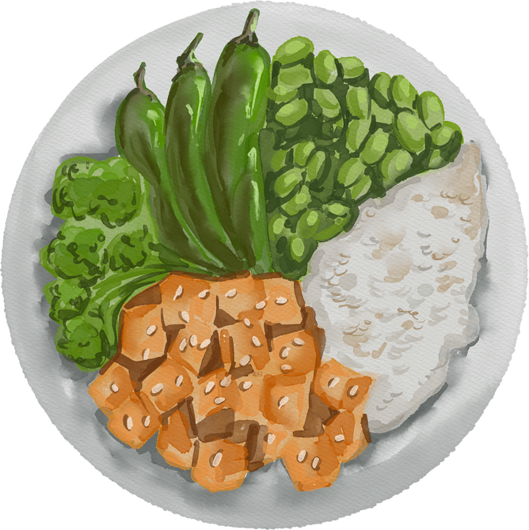
Summary:
Diabetes: a condition in which your body cannot properly use or store energy from food
Aim for 3 meals per day, 4-6 hours apart
Try to include a variety of foods from all the food groups.
Aim for a balanced plate: ¼ plate protein, ¼ plate whole grains and ½ plate vegetables and fruit
Diabetes Canada. (2025). Basic meal planning. https://www.diabetes.ca/resources/tools-resources/basic-meal-planning

Slide 6


DIABETES ACTIVITY PROGRAM
DIABETES ACTIVITY PROGRAM
Knowledge to action for better health
This program is sponsored by Boehringer Ingelheim through the K2A Challenge in Diabetes! in partnership with Bancroft Fitness and the Bancroft Community Family Health Team

